Slide 1
Language technology for low-resource languages
Day 2/5
LOT 2018, Groningen
Yves Scherrer, University of Helsinki

Slide 2
What resources can we get?
Is there manually annotated training data?
yes
no
Use supervised NLP techniques
Is there relevant training data from other languages?
yes
no
Use cross-lingual learning methods
Are there monolingual corpora?
First topic
Main topic of this course
yes
no
Use unsupervised NLP techniques
Annotate data
Collect and annotate data
Adapted from Y. Tsvetkov

Slide 3
If you don’t have resources...
... create some!

Slide 4
Case study: Learning taggers from 2 hours of annotation
How good a tagger can one get with only 2 hours of annotation work?
Assumption: monolingual raw data is available
Tagging is a sequence labeling task:
Every item (word) of a sequence (sentence) gets a label (part-of-speech)
What is the best data annotation strategy?
Token supervision: Annotate complete sentences
Type supervision: Annotate the most frequent words in isolation
Can the results be improved with appropriate machine learning methods?

Slide 5
Case study: Learning taggers from 2 hours of annotation
A (simple) tagger needs to learn two things:
Emissions: the most probable associations between words and tags
Transitions: the most probable sequences of tags
Approach 1: annotate a corpus (“tokens”)
Emissions can be learned easily, and frequency information is available
Downside: the same words end up being annotated several times
Transitions can be learned easily
Approach 2: annotate a word list (“types”)
Emissions can be learned easily, but frequency information is not readily available (in case of ambiguity)
More efficient, as each form is annotated only once
Transitions cannot be learned easily (needs 2 passes over data)

Slide 6
Experimental setup
Linguist A
Linguist B
Kinyarwanda 14 tags, Malagasy 24 tags, English 45 tags
Additional unannotated data: 100 000 words/language
Annotated sentences for evaluation (by the same linguists, but not included in the 2h-tasks)
 | Kinyarwanda (Rwanda) | English | Malagasy (Madagascar) | English
2h token annotation | 90 sentences 1537 tokens 750 types | 86 sentences 1897 tokens 903 types | 92 sentences 1805 tokens 666 types | 107 sentences 2650 tokens 959 types
2h type annotation | 1798 types | 1644 types | 1067 types | 1090 types
Notes:
Vergleichbare Effizienz zwischen der exotischen Sprache und Englisch
Linguist A ist besser für die isolierten Wörter, LInguist B ist besser für die Sätze
Deutsch/Englisch + TnT: ca. 85%

Slide 7
Experiment 0
Train a tagger with the ~100 annotated sentences:
T = Total K = Known words (seen during training) U = Unknown words (not seen during training)

Slide 8
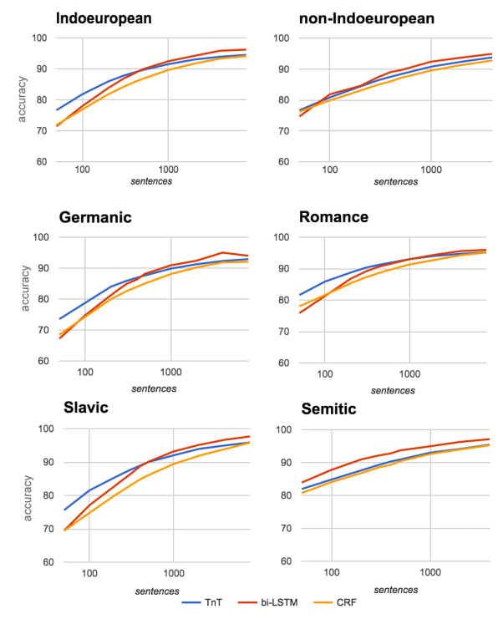
Experiment 0
Train a tagger with the ~100 annotated sentences:
T = Total K = Known words (seen during training) U = Unknown words (not seen during training)

Slide 9
Experiment 1
Train tagger on word list and unannotated data
Constrain prediction for known words (those in the word list)
Assume uniform tag distribution for unknown words
Several passes over the text using EM (Expectation Maximisation)

Slide 10
Experiment 1
Train a tagger with the 100 annotated sentences and the unannotated sentences
Annotate the raw text with the 100-sentence tagger
Optimize tag associations and emissions in several passes through the raw text using EM

Slide 11
Tag dictionary expansion: Label propagation
For a lot of words, the possible tags are unknown.
Adding unannotated data does not help much in this respect. (Why?)
How can we determine the most probable tags for unknown words?
Label propagation: a machine learning algorithm to transfer labels (=tags) to similar words
What are similar words?
Words with the same suffix or prefix
Words with the same predecessor or successor in a sentence
All these properties are inserted into a graph.
Tags are assigned to the known words and then transferred onto the similar words.

Slide 12
Tag dictionary expansion: Label propagation
A dog barks.
The dog walks.
The man walks.

Slide 13
Experiment 2
LP computes a tag distribution for every word
The unannotated corpus is annotated with the tags found by LP, then a new tagger is trained.

Slide 14
Experiment 2
LP computes a tag distribution for every word
The unannotated corpus is annotated with the tags found by LP, then a new tagger is trained.

Slide 15
Model minimization
Label propagation introduces a lot of noise (i.e. wrong tags)
A lot of tag combinations (of two adjacent words in the text) never occur.
Goal: find the minimal set of tag combinations
Tags are weighted according to the LP result
The tag combinations with the highest weight are added

Slide 16
Model minimization

Slide 17
Experiment 3
Model minimization creates an optimal tag sequence for each unannotated sentence.
A new tagger is trained on this data.
Notes:
LP und min helfen nicht für Token-Annotationen, aber schon für Type-Annotationen.

Slide 18
Experiment 3
Model minimization creates an optimal tag sequence for each unannotated sentence.
A new tagger is trained on this data.

Slide 19
Examples

Slide 20
External dictionary
Kinyarwanda:
3700 entries (kinyarwanda.net)
Malagasy:
78'000 entries (malagasyworld.org)
English:
614'000 entries (Wiktionary)
Wiktionary is too small for Kinyarwanda (9 entries) and for Malagasy (3365 entries).
Dictionary data is incorporated into the LP graph.

Slide 21
Experiment 4
Include the external dictionary in the label propagation graph, train new tagger on this data
Conclusion: spending more time on enlarging the dictionary may not be helpful…

Slide 22
Conclusions
What is more efficient, type or token annotations?
Annotators have personal preferences
In general, it is more efficient to create type annotations (word lists)
No repetitions, thus better coverage in the same period
Focus on most frequent (thus most useful) words
Tag frequencies and distributions can also be estimated from an unannotated corpus (and the appropriate machine learning techniques)

Slide 23
Cross-lingual learning
Transfer learning

Slide 24
What resources can we get?
Is there manually annotated training data?
yes
no
Use supervised NLP techniques
Is there relevant training data from other languages?
yes
no
Use cross-lingual learning methods
Are there monolingual corpora?
Main topic of this course
yes
no
Use unsupervised NLP techniques
Annotate data
Collect and annotate data
Adapted from Y. Tsvetkov

Slide 25
Cross-lingual learning / Transfer learning
We have the data to train a model for language A, but need a model for language B
Languages A and B may be related, but not necessarily
Different methods, depending on where in the process the switch/transfer from A to B occurs
A = high-resource language (HRL)
B = low-resource language (LRL)

Slide 26
Cross-lingual learning techniques
We have the data to train a model for language A, but need a model for language B
Data transfer:
Convert the training data to language B
Train a model on the converted data of language B
Annotation projection, data translation
Model transfer:
Train a model for language A
Convert the model so that it applies to language B
Plain model transfer, delexicalization, relexicalization
Multilingual/multitask models
Today
Tomorrow

Slide 27
Cross-lingual learning techniques
Example task:
Part-of-speech tagging
Data transfer – the ideal setup:
Word-aligned parallel corpus whose A side is manually annotated:
Task:
Copy all annotations along alignment links to B
Easier said than done...
Train model on annotated B side
ADP | DET | NOUN | AUX | DET | NOUN | PUNCT
In | the | beginning | was | the | word | .
Am |  | Anfang | war | das | Wort | .

Slide 28
Cross-lingual learning techniques
Data transfer – the common setup:
Annotated monolingual corpus of language A:
Word-aligned but unannotated parallel corpus:
How can we connect the two?
ADV | DET | NOUN | AUX | ADV | ADJ | PUNCT
Maybe | the | dresscode | was | too | stuffy | .
In | the | beginning | was | the | word | .
Am |  | Anfang | war | das | Wort | .

Slide 29
Cross-lingual learning techniques
Data transfer – annotation projection:
Parallel data set and annotated A corpus are disjoint
Train A model on annotated A corpus
Annotate A side of parallel data with it
Copy all annotations along alignment links to B
Train model on annotated B side
ADP | DET | NOUN | AUX | DET | NOUN | PUNCT
In | the | beginning | was | the | word | .
Am |  | Anfang | war | das | Wort | .
ADP |  | NOUN | AUX | DET | NOUN | PUNCT

Slide 30
Cross-lingual learning techniques
Data transfer – training data translation:
Parallel data set and annotated A corpus are disjoint
Train A-B machine translation model on parallel data
Translate annotated A corpus
Copy all annotations along alignment links to B
Train model on annotated B side
ADV | DET | NOUN | AUX | ADV | ADJ | PUNCT
Maybe | the | dresscode | was | too | stuffy | .
Vielleicht | war | der | Dresscode | zu | spießig | .
ADV | AUX | DET | NOUN | ADV | ADJ | PUNCT

Slide 31
Cross-lingual learning techniques
Data transfer – test data backtranslation:
Parallel data set and annotated A corpus are disjoint
Train A model on annotated A corpus
Train B-A machine translation model on parallel data
Translate B test corpus to A
Annotate translated corpus with A model
Project annotations back to B
DET | ADJ | ADJ | NOUN | VERB | NUM | NOUN | PUNCT
The | current | waiting | period | is | eight | weeks | .
Die | aktuelle | Wartezeit |  | beträgt | acht | Wochen | .

Slide 32
Cross-lingual learning techniques
Data transfer – test data backtranslation:
Why would one choose this option?
This approach is typical for historical language varieties:
A = present-day variety
B = historical variety
B-A translation = normalization / modernization
Why?
The historical variety is not standardized
Translation from B to A is easier than from A to B

Slide 33
Annotation projection

Slide 34
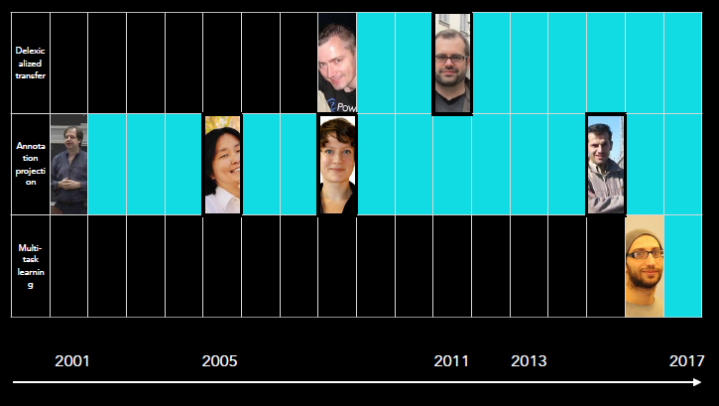
Vulić, Søgaard & Faruqui: Tutorial on cross-lingual word representations, EMNLP 2017. http://people.ds.cam.ac.uk/iv250/tutorial/xlingrep-tutorial.pdf

Slide 35
Reading
Pioneering paper on annotation projection:
David Yarowsky & Grace Ngai: Inducing multilingual POS taggers and NP bracketers via robust projection across aligned corpora. NAACL 2001.
Questions:
What is the task of word alignment about?
What can go wrong when using direct projection, as illustrated by the examples in Figure 2?
Annotation projection assumes that it is easier to obtain a parallel corpus (and a tagger for the high-resource language) than a directly annotated corpus for the low-resource language. Do you agree with this assumption?
Notes:
Have you used word alignment tools? Which ones?

Slide 36
Word alignment tools
GIZA++ and Moses helper scripts
https://github.com/moses-smt/mgiza
http://www.statmt.org/moses/?n=Development.GetStarted
fast_align
https://github.com/clab/fast_align
efmaral
https://github.com/robertostling/efmaral
Anymalign
https://anymalign.limsi.fr/

Slide 37
Word alignment
Example input for fast_align:
Example output from fast_align:
doch jetzt ist der Held gefallen . ||| but now the hero has fallen .
neue Modelle werden erprobt . ||| new models are being tested .
doch fehlen uns neue Ressourcen . ||| but we lack new resources .
0-0 1-1 2-4 3-2 4-3 5-5 6-6
0-0 1-1 2-2 2-3 3-4 4-5
0-0 1-2 2-1 3-3 4-4 5-5

Slide 38
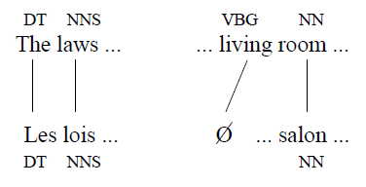
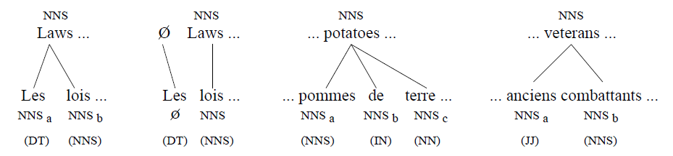
Direct projection

Slide 39
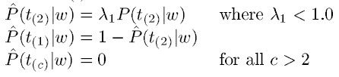
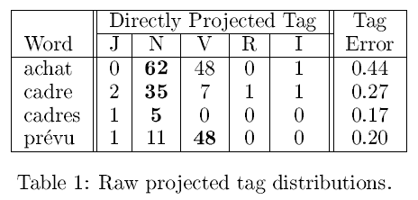
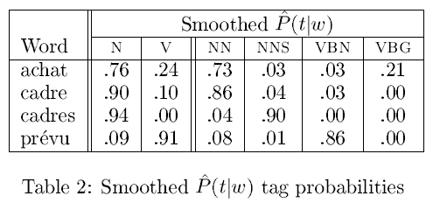
Noise reduction
Noise reduction techniques are directly applied to the B tagger training process.
The projected corpus remains noisy.

Slide 40
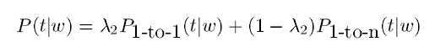
Noise reduction

Slide 41
Annotation projection
Annotation projection assumes that it is easier to obtain a parallel corpus (and a tagger for the high-resource language) than a directly annotated corpus for the low-resource language.
Do you agree with this assumption?

Slide 42
Annotation projection
Authors | Task | Languages
Yarowsky & Ngai 2001 | POS tagging NP chunking | EN→FR EN→FR, EN→ZH
Yarowsky et al. 2001 | Morphology | EN→FR
Riloff et al. 2002 | Information extraction | EN→FR
Diab & Resnik 2002 | Word sense disambiguation | EN↔︎FR
Hwa et al. 2005 | Dependency parsing | EN→EU (Basque), EN→ES, EN→ZH
Lapata & Padó 2005 | Semantic role labeling | EN→DE
Das & Petrov 2011 | POS tagging | EN→DA, DE, EL, ES, IT, NL, PT, SV
McDonald et al. 2011 | Dependency parsing | All combinations of EN, DA, DE, EL, ES, IT, NL, PT, SV
Duong et al. 2013 | POS tagging | EN→DA, DE, EL, ES, IT, NL, PT, SV

Slide 43
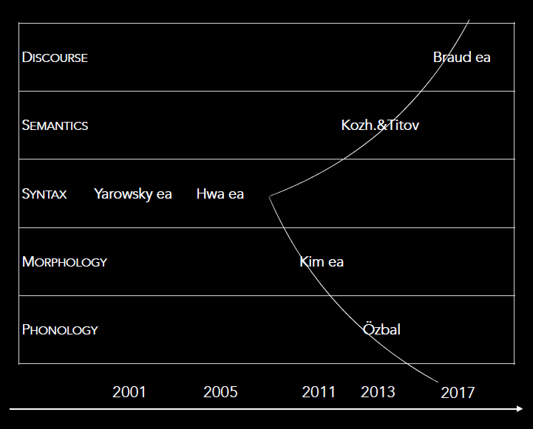
Annotation projection
Vulić, Søgaard & Faruqui: Tutorial on cross-lingual word representations, EMNLP 2017. http://people.ds.cam.ac.uk/iv250/tutorial/xlingrep-tutorial.pdf

Slide 44
Morphology
Arrows: alignment links
Idea: croyant and croire belong to the same verb because they are linked by believing

Slide 45
Morphology
The English side of the corpus can be annotated with lemmas:
croyaient is linked with believed (alignment)
believed is linked with believe (lemmatization)
believe is linked with croire (alignment)
croyaient is a morphological variant of croire

Slide 46
Information extraction
Texts about plane crashes
Ad-hoc annotation of the English data:
location, vehicle, victim
Parallel data are created by MT system, thus noisy

Slide 47
Word sense disambiguation
tragedy
disaster
catastrophe
catastrophe
tragedy_{CALAMITY / *DRAMA}
disaster_{CALAMITY}
catastrophe
catastrophe
Notes:
calamity = Unglück

Slide 48
Semantic role labeling
Both sides of the parallel corpus are parsed
Role annotations are projected onto aligned constituents

Slide 49
Dependency parsing

Slide 50
Dependency parsing
DCA:
English-Spanish: 37% English-Chinese: 38%
Main problem: Unaligned words
Aspect markers in Chinese
Reflexive pronouns in Spanish
Solution: Post-projection transformation rules
Example: An aspect marker modifies a verb to its left.
With transformation rules:
English-Spanish: 70% English-Chinese: 67%
After training a target language parser on the projected data:
Spanish: 72% Chinese: 64%

Slide 51
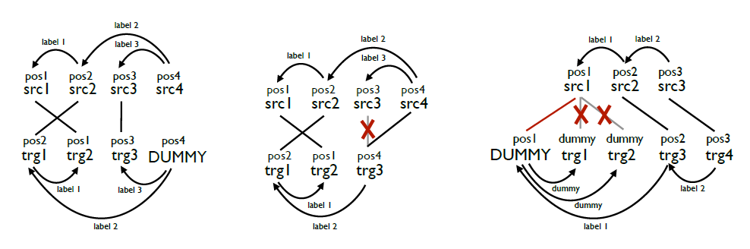
Dependency parsing
Tiedemann (2014): dummy nodes

Slide 53
Annotation projection
Authors | Task | Languages
Yarowsky & Ngai 2001 | POS tagging NP chunking | EN→FR EN→FR, EN→ZH
Yarowsky et al. 2001 | Morphology | EN→FR
Riloff et al. 2002 | Information extraction | EN→FR
Diab & Resnik 2002 | Word sense disambiguation | EN↔︎FR
Hwa et al. 2005 | Dependency parsing | EN→EU (Basque), EN→ES, EN→ZH
Lapata & Padó 2005 | Semantic role labeling | EN→DE
Das & Petrov 2011 | POS tagging | EN→DA, DE, EL, ES, IT, NL, PT, SV
McDonald et al. 2011 | Dependency parsing | All combinations of EN, DA, DE, EL, ES, IT, NL, PT, SV
Duong et al. 2013 | POS tagging | EN→DA, DE, EL, ES, IT, NL, PT, SV

Slide 54
2011 – Was has changed?
Parallel corpora are available for many language pairs
Europarl, OPUS, ...
POS-annotated texts and treebanks are available for many languages (with common label sets)
Required for evaluating the projected annotations (simulation of low-resource setting)
More powerful machine learning techniques
Google expands and is interested in language technology
Better search indexing for more languages
Parsing to improve machine translation and search
Parsing and coreference resolution for question answering systems

Slide 55
Annotation projection
Authors | Task | Languages
Yarowsky & Ngai 2001 | POS tagging NP chunking | EN→FR EN→FR, EN→ZH
Yarowsky et al. 2001 | Morphology | EN→FR
Riloff et al. 2002 | Information extraction | EN→FR
Diab & Resnik 2002 | Word sense disambiguation | EN↔︎FR
Hwa et al. 2005 | Dependency parsing | EN→EU (Basque), EN→ES, EN→ZH
Lapata & Padó 2005 | Semantic role labeling | EN→DE
Das & Petrov 2011 Google | POS tagging | EN→DA, DE, EL, ES, IT, NL, PT, SV
McDonald et al. 2011 Google | Dependency parsing | All combinations of EN, DA, DE, EL, ES, IT, NL, PT, SV
Duong et al. 2013 | POS tagging | EN→DA, DE, EL, ES, IT, NL, PT, SV

Slide 56
Das & Petrov 2011
Improvements compared to Yarowsky & Ngai 2001:
No direct projection
Instead, create a graph and apply label propagation
Different machine learning technique for tagger training
Unsupervised instead of supervised learning
Universal POS tag set
12 word categories aimed to be valid in all languages
Thus, easier comparison across languages

Slide 57
Das & Petrov 2011
No direct projection, but graph creation and label propagation
Monolingual similarity
Links between words that occur in the same contexts
Bilingual similarity
Links between aligned words in the parallel corpus

Slide 58
Das & Petrov 2011
Projection: like Yarowsky & Ngai
In all experiments, the source language is English

Slide 59
Das & Petrov 2011
No LP: tags are propagated only along one edge in the graph

Slide 60
Das & Petrov 2011
With LP: with complete label propagation

Slide 61
Das & Petrov 2011
Supervised: high-resource scenario, for comparison purposes
Tagger trained directly with annotated data of target language

Slide 62
Duong et al. 2013
The model of Das & Petrov is unnecessarily complicated
Better results can be obtained with a simpler approach:
Train a target language tagger using projected data (like Y&N)
Improve the tagger by self-training and revision
Projection – only with a small part of the parallel corpus:
Annotate source side
Align corpus
Project tags onto target side
Only use 1-1 alignment links
High precision, but many words remain untagged
Estimate emission and transition probabilities separately
Estimate transition probabilities only on the “best” sentences (< 10% untagged words, > 4 words long)

Slide 63
Duong et al. 2013
Now, we use the rest of the parallel corpus…
Step 3:
ws_{i}, ts_{i}: source language word and tag
wt_{j}, tt_{j}: target language source and tag
If ws_{i} is aligned with wt_{j} but ts_{i} ≠ tt_{j}, then tt_{j} ← ts_{i}

Slide 64
Duong et al. 2013

Slide 65

If all you have is a bit of the Bible…
Ž. Agić, D. Hovy, A. Søgaard (2015): If all you have is a bit of the Bible: Learning POS taggers for truly low-resource languages.
http://www.domnik.net/photos/kuvia/000/big/006/51-kampinkappeli.jpg

Slide 66
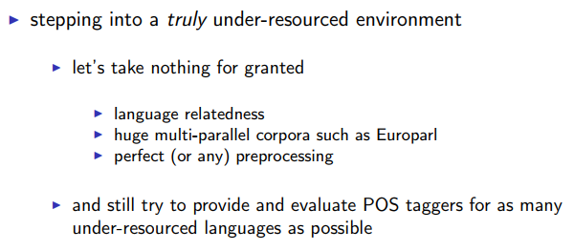
If all you have is a bit of the Bible…
Ž. Agić, D. Hovy, A. Søgaard (2015): If all you have is a bit of the Bible: Learning POS taggers for truly low-resource languages.
Motivation:

Slide 67
If all you have is a bit of the Bible…
Translations of parts of the Bible exist for a huge number of languages:
Edinburgh Bible parallel corpus: 100 languages [used here] http://homepages.inf.ed.ac.uk/s0787820/bible/
Parallel bible corpus: 1169 languages/varieties http://paralleltext.info/data/
Web sources: 1646 languages http://www.bible.is/
Sentence alignments are easy to obtain: verse IDs
Split into k high-resource languages and m low-resource languages, project from all k to all m: multi-source projection

Slide 68
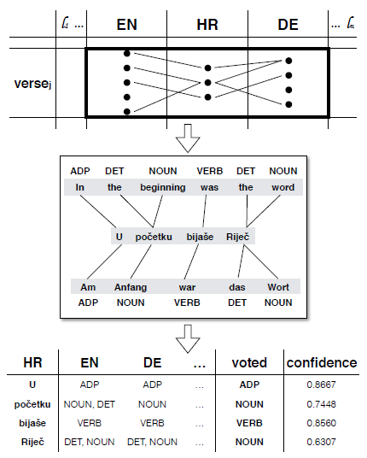
If all you have is a bit of the Bible…

Slide 69
If all you have is a bit of the Bible…
Iterative process:
Tag the k high-resource language Bibles. Project tags from k languages to m languages. Choose tags by majority voting.
Train taggers for m low-resource languages using the projected data and tag the m low-resource languages (self-training). Project tags from (k+m)-1 to other (k+m)-1 languages. Choose tags by majority voting.
Train taggers for k+m languages using the projected data.
k = 18 languages, m = 82 languages

Slide 70
If all you have is a bit of the Bible…
Low-resource languages include Akawaio, Aukan, Cakchiquel, Ewe, Haitian Creole, Manx, Maori, Somali, Ukrainian, …
How do you evaluate this?
Test sets available for 25 languages
Wiktionary data available for 10 more languages → Compute to what extent the projected tag dictionaries overlap with the Wiktionary data

Slide 71
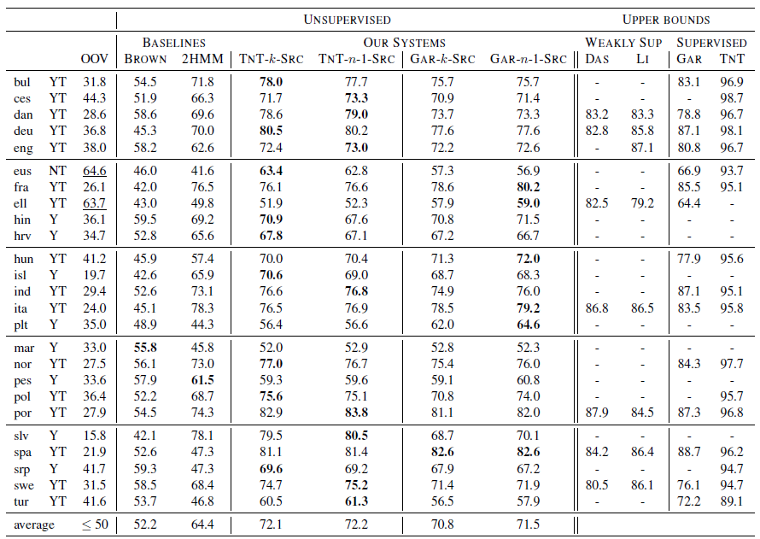

Slide 72
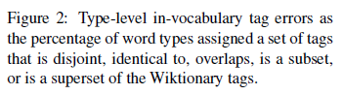
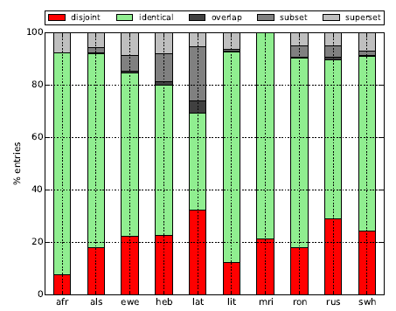
Evaluation

Slide 73
Training corpus translation
In case of parsing: treebank translation

Slide 74
Readings
Jörg Tiedemann & Željko Agić (2016): Synthetic treebanking for cross-lingual dependency parsing. JAIR 55. (Sections 1 and 2)
What is the difference between model transfer and data transfer?
What is the difference between annotation projection and treebank translation? What are the advantages of the latter according to the authors?
What are the problems regarding cross-lingual parsing evaluation?

Slide 75
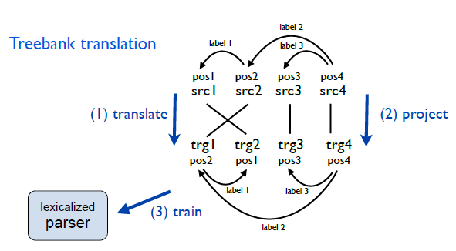
Treebank translation

Slide 76
Advantages
Word alignment naturally comes out of the translation process and is not another source of noise.
Work directly on the manually annotated data, not on automatically annotated data of language A, which may contain errors.
(S)MT output tends to be more literal than manually translated sentences in a parallel corpus, so projection is more straigthtforward.

Slide 77
Drawbacks
Depends on quality of MT system (and thus, on the available parallel corpora)
For closely related languages, rule-based (or otherwise bootstrapped) MT systems may be sufficient
Depends on projection quality (but to the same extent as annotation projection)

Slide 78
Tomorrow...

Slide 79
Readings
Ryan McDonald, Slav Petrov & Keith Hall (2011): Multi-source transfer of delexicalized dependency parsers. Proceedings of EMNLP. https://www.aclweb.org/anthology/D11-1006
Oscar Täckström, Ryan McDonald & Jakob Uszkoreit (2012): Cross-lingual word clusters for direct transfer of linguistic structure. Proceedings of NAACL-HLT. http://aclweb.org/anthology/N/N12/N12-1052.pdf

Slide 80
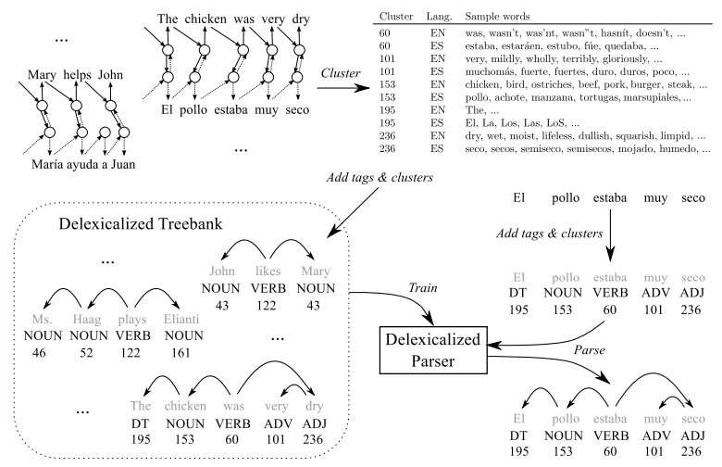
Questions
McDonald et al. 2011:
What is delexicalization?
The authors propose to use delexicalization for parsing. Would this approach also work for other tasks, such as part-of-speech tagging?
Täckström et al. 2012:
Try to understand and explain Figure 1.

